Slide 1
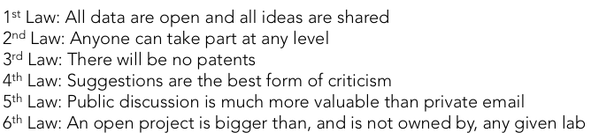

Open Source Research
Open Source Malaria
Twitter: @O_S_M
Open Source Chemistry Project for Drug Synthesis:
Nature Chemistry 2011, 3, 745-748; PLoS NTD 2011, 5(9): e1260
First Open Source Malaria paper:
ACS Cent. Sci. 2016, 2, 687–701

Slide 2
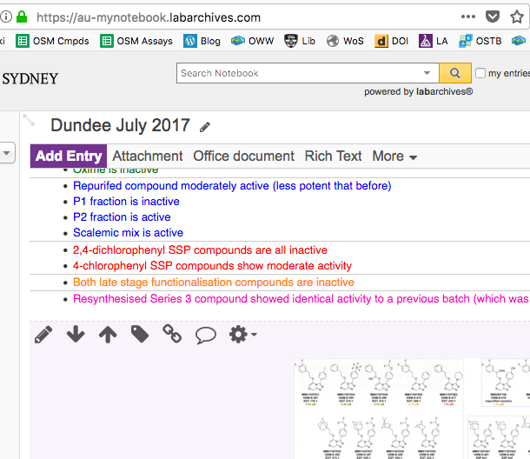
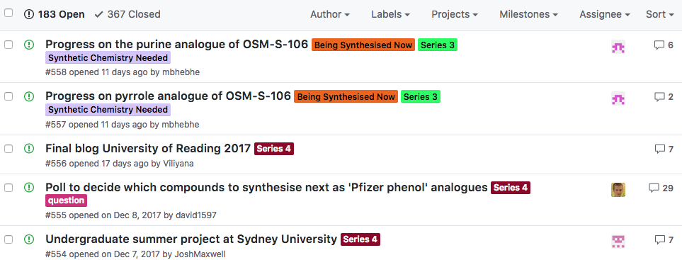
How Does it Work?
Discussion/Wiki/To Do List
We’ve hijacked/repurposed Github, but don’t know what we’re doing
Electronic Lab Notebook
Real-time, open deposition of all research data. The bedrock.
https://github.com/OpenSourceMalaria

Slide 3
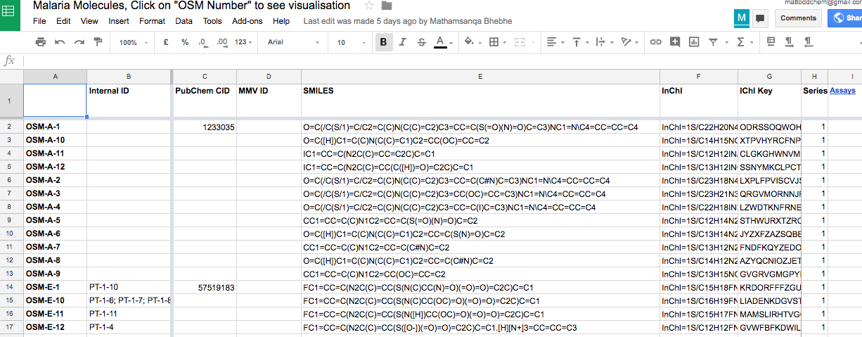
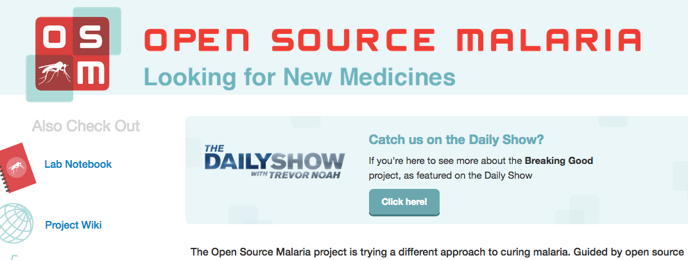
How Does it Work?
Open Data
Details of all molecules and their potencies. Easy to reuse.
Landing Page, SocMed
Need to be discovered, and to reach out to people.
http://tinyurl.com/OSM-Compounds
http://opensourcemalaria.org/
@O_S_M

Slide 4

Highly amenable to
Crowdsourced, Open Educational Initiatives
Nov ’12
Apr ‘13
Nov ‘14
Feb ‘15
Oct ‘15
Mar ‘16
Jun ‘16
’18 –

Slide 5
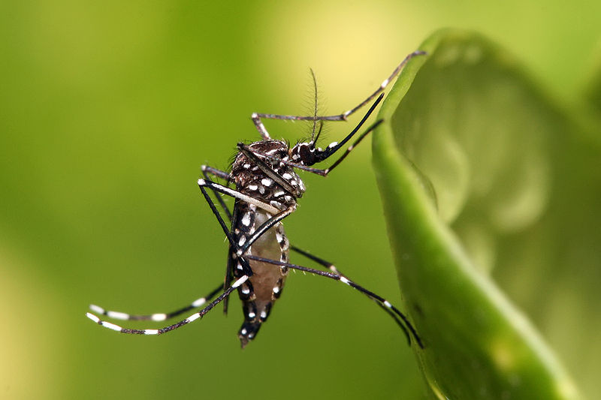

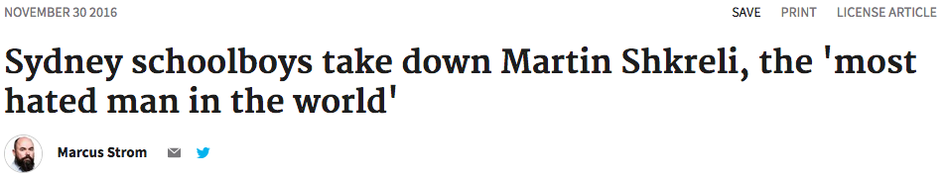
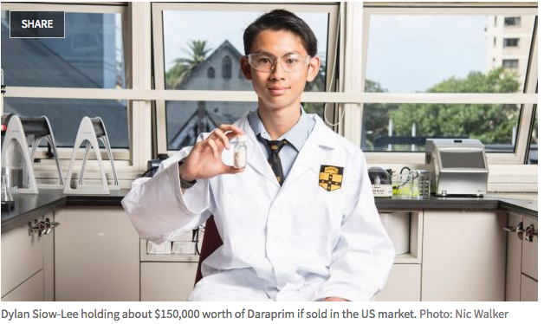
“Breaking Good”: Crowdsourced Synthesis

Slide 6
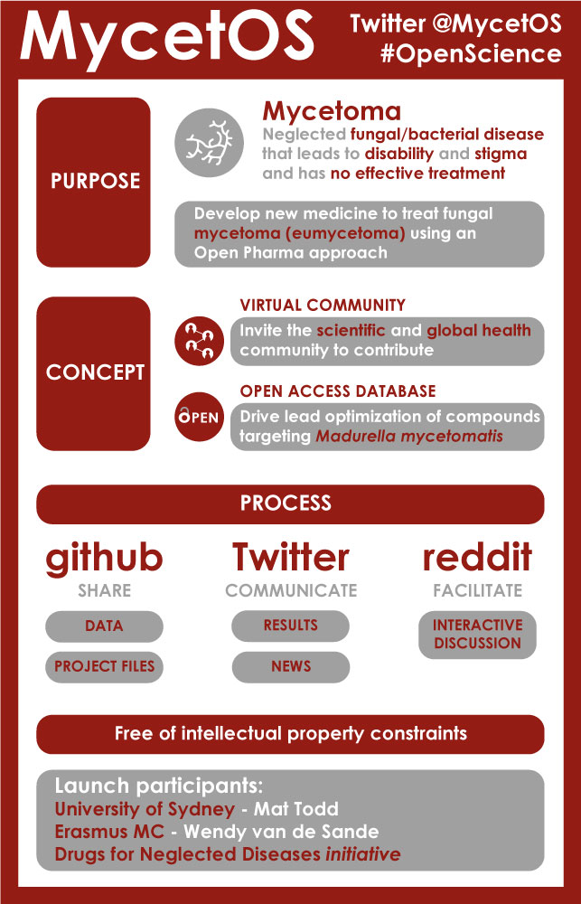


Easy to Clone this Approach
Open Source Tuberculosis
Open Source … Antibacterials…?
Interested?
Prof Matthew Todd
@mattoddchem
Open Source Mycetoma

